Slide 1


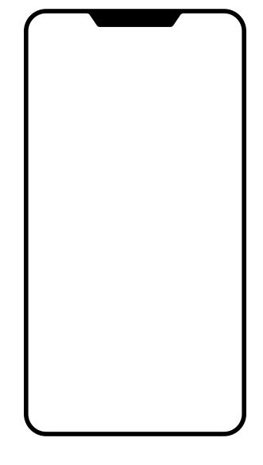


User Churn Project | Two-Sample Hypothesis Test Results
The Waze data team is developing a data analytics project to drive overall growth by reducing monthly user churn on the Waze app. As part of this initiative to improve retention, Waze is focusing on gaining a deeper understanding of user behavior. This report provides an update on the project status and presents the findings from Milestone 4, which will inform the next steps in the project’s development.
🎯 Target Goal Conduct a two-sample hypothesis test to evaluate whether the mean number of rides differs significantly between Android and iPhone users.
🎯 Impact This statistical test allows the Waze data team to draw inferences about user populations and gain a deeper understanding of behavioral differences across device types, supporting data-driven strategies to improve retention.
Average Number of Drives
📊 Key Finding
iPhone users showed a slightly higher average number of drives compared to Android users.
However, the two-sample t-test results indicate this difference is not statistically significant, meaning device type does not appear to impact driving frequency.
66
68
Note: The mean number of drives shown here – 66 for Android and 68 for iPhone – have been rounded up.
✅ Recommendations
Conduct additional t-tests on other key variables to gain deeper insights into user behavior.
Since no difference was found between iPhone and Android users, future efforts could focus on marketing strategies or user interface experiments to generate more behavioral data and uncover drivers of churn.
Notes:
Image Credits
Android Phone Icon: Created by Devendra Karkar from the Noun Project
iPhone Icon: Created by Landan Lloyd from the Noun Project

